Slide 1
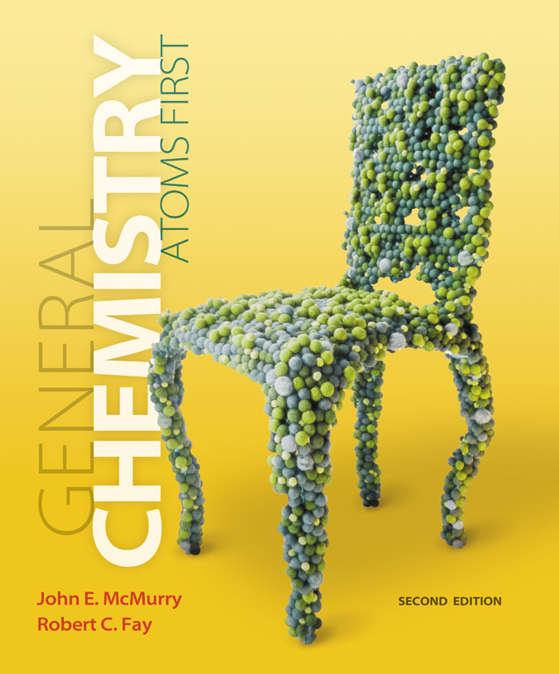
Clicker Questions
Chapter 0
Chemical Tools: Experimentation and Measurement
Donald Linn
Indiana University–
Purdue University Fort Wayne
Fort Wayne, IN

Slide 2
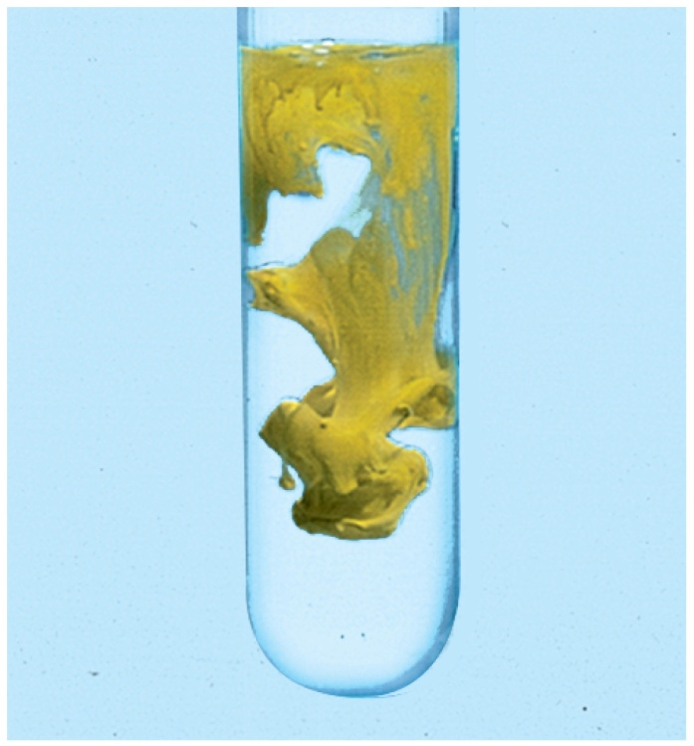
Which of the following is a physical observation?
a) Burns in oxygen
b) Melts at 76 °C
c) Forms a white precipitate
d) Decomposes in air
e) Cooks at high temperature
Reaction of aqueous
Pb(NO₃)₂ with aqueous
KI gives a yellow precipitate
of PbI₂.
Notes:
Answer: b

Slide 3
Which of the following is a physical observation?
a) Burns in oxygen
b) Melts at 76 ° C
c) Forms a white precipitate
d) Decomposes in air
e) Cooks at high temperature
Reaction of aqueous
Pb(NO₃)₂ with aqueous
KI gives a yellow precipitate
of PbI₂.
Notes:
Answer: b

Slide 4
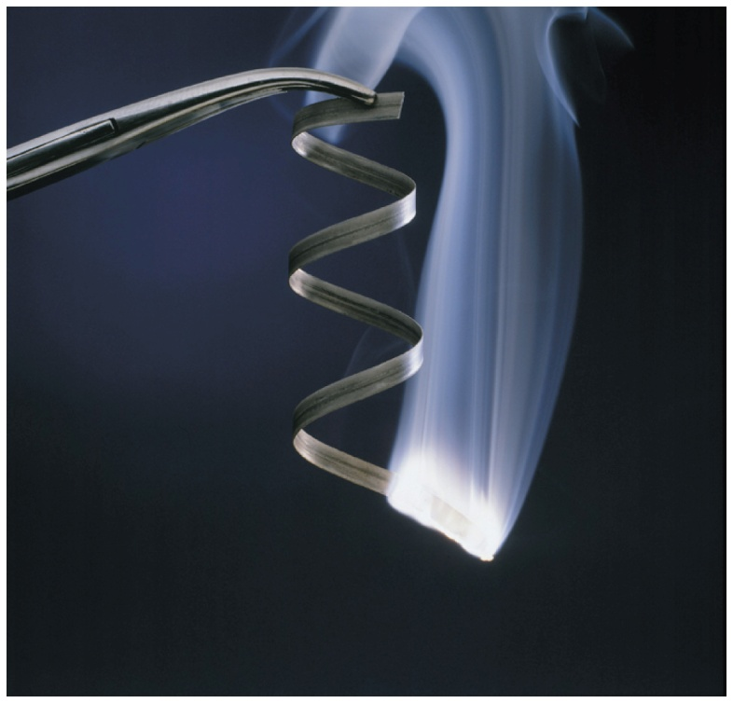
Which of the following is an observation of a chemical property?
a) Orange crystal
b) Boils at 112 ° C
c) Smells like mint
d) Ignites in water
Magnesium metal burns in air to produce magnesium oxide.
e) Shatters when hammered
Notes:
Answer: d

Slide 5
Which of the following is an observation of a chemical property?
a) Orange crystal
b) Boils at 112 ° C
c) Smells like mint
d) Ignites in water
Magnesium metal burns in air to produce magnesium oxide.
e) Shatters when hammered
Notes:
Answer: d

Slide 6
Which of the following is chemical process?
a) Removing fish from water
b) Removing the salt from sea water
c) Separating honey into sugar and water
d) Separating water into hydrogen and oxygen
e) Dissolving coffee in water
Notes:
Answer: d

Slide 7
Which of the following is chemical process?
a) Removing fish from water
b) Removing the salt from sea water
c) Separating honey into sugar and water
d) Separating water into hydrogen and oxygen
e) Dissolving coffee in water
Notes:
Answer: d

Slide 8
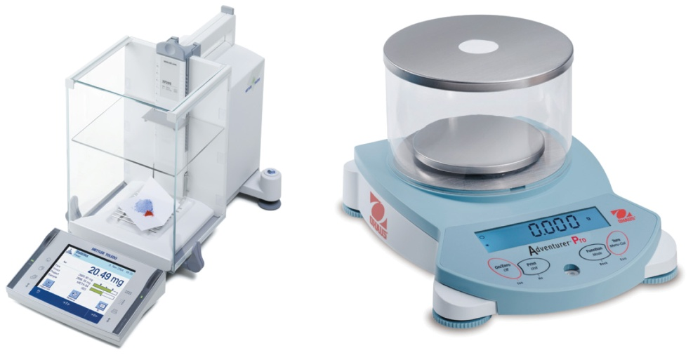
A fishing boat accidentally spills 15 barrels of diesel
oil (d = 0.85 g/mL) into the ocean. Each barrel contains
42 gallons. If the oil film on the ocean is 2.5 × 10² nm thick, how many grams of oil has been spilled?
a) 187 kg
b) 1.87 × 10⁵ kg
c) 1.35 × 10⁵ kg
d) 135 kg
e) 1.35 × 10⁵ kg
Notes:
Answer: d

Slide 9
A fishing boat accidentally spills 15 barrels of diesel
oil (d = 0.85 g/mL) into the ocean. Each barrel contains
42 gallons. If the oil film on the ocean is 2.5 × 10² nm thick, how many grams of oil has been spilled?
a) 187 kg
b) 1.87 × 10⁵ kg
c) 1.35 × 10⁵ kg
d) 135 kg
e) 1.35 × 10⁵ kg
Notes:
Answer: d

Slide 10
A fishing boat accidentally spills 15 barrels of diesel
oil (d = 0.85 g/mL) into the ocean. Each barrel contains 42 gallons. If the oil film on the ocean is 2.5 × 10² nm thick, how many square meters of oil has been spilled?
a) 9.5 × 10^{–3} m²
b) 9.5 × 10⁶ m²
c) 9.5 × 10⁷ m²
d) None of the above
Notes:
Answer: b

Slide 11
A fishing boat accidentally spills 15 barrels of diesel
oil (d = 0.85 g/mL) into the ocean. Each barrel contains 42 gallons. If the oil film on the ocean is 2.5 × 10² nm thick, how many square meters of oil has been spilled?
a) 9.5 × 10^{–3} m²
b) 9.5 × 10⁶ m²
c) 9.5 × 10⁷ m²
d) None of the above
Notes:
Answer: b

Slide 12
The length of the Colorado River in the Grand Canyon is 446 000 m. This distance expressed in scientific notation is (choose the best answer)
a) 446 × 10³ m.
b) 4.46 × 10⁶ m.
c) 4.5 × 10⁵ m.
d) 4.46 × 10³ m.
e) 4.46 × 10⁵ m.
Notes:
Answer: e

Slide 13
The length of the Colorado River in the Grand Canyon is 446 000 m. This distance expressed in scientific notation is (choose the best answer)
a) 446 × 10³ m.
b) 4.46 × 10⁶ m.
c) 4.5 × 10⁵ m.
d) 4.46 × 10³ m.
e) 4.46 × 10⁵ m.
Notes:
Answer: e

Slide 14
The diameter of a nickel atom is 270 pm. In scientific notation, and expressed in meters, this distance is
a) 2.70 × 10^{–2} m.
b) 2.70 × 10^{–7} m.
c) 2.70 × 10^{–9} m.
d) 2.70 × 10^{–10} m.
e) 2.70 × 10^{–12} m.
Notes:
Answer: d

Slide 15
The diameter of a nickel atom is 270 pm. In scientific notation, and expressed in meters, this distance is
a) 2.70 × 10^{–2} m.
b) 2.70 × 10^{–7} m.
c) 2.70 × 10^{–9} m.
d) 2.70 × 10^{–10} m.
e) 2.70 × 10^{–12} m.
Notes:
Answer: d

Slide 16
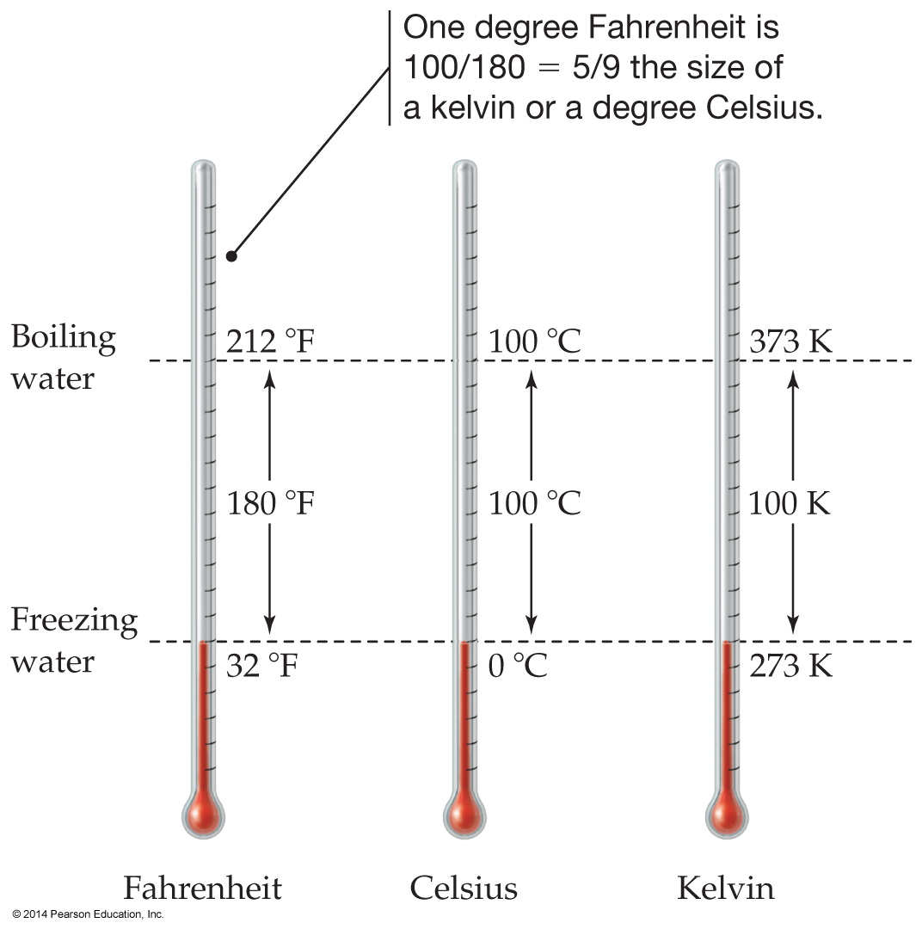
Ethanol boils at 173.1 ° F. This temperature in K is
a) 337.4.
b) 351.5.
c) 387.1.
d) 401.4.
e) 552.8.
Notes:
Answer: b

Slide 17
Ethanol boils at 173.1 °F. This temperature in K is
a) 337.4.
b) 351.5.
c) 387.1.
d) 401.4.
e) 552.8.
Notes:
Answer: b

Slide 18
According to Wikipedia, the Aerium in Halbe, Brandenburg, Germany was built to house the construction of a giant airship. It is the third-largest building in the world with a volume of 5.2 million m³. The volume in km³ is
a) 5 200 000 km³.
d) 5.2 × 10^{–3} km³.
b) 5 200 km³.
e) 5.2 × 10^{–6} km³.
c) 5.2 km³.
Notes:
Answer: d

Slide 19
According to Wikipedia, the Aerium in Halbe, Brandenburg, Germany was built to house the construction of a giant airship. It is the third-largest building in the world with a volume of 5.2 million m³. The volume in km³ is
a) 5 200 000 km³.
d) 5.2 × 10^{–3} km³.
b) 5 200 km³.
e) 5.2 × 10^{–6} km³.
c) 5.2 km³.
Notes:
Answer: d

Slide 20
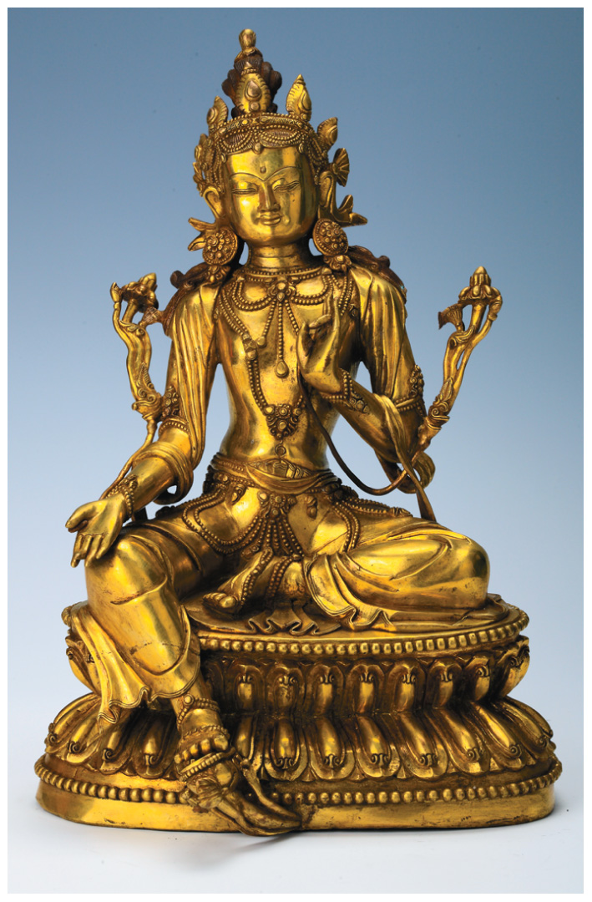
The density of gold is 19.31 g cm^{–3}. What is the volume of a piece of gold weighing 294 g?
a) 5.67 × 10³ cm³
b) 15.2 cm³
c) 0.0657 cm³
d) 5677 cm³
e) None of the above
Notes:
Answer: b

Slide 21
The density of gold is 19.31 g cm^{–3}. What is the volume of a piece of gold weighing 294 g?
a) 5.67 × 10³ cm³
b) 15.2 cm³
c) 0.0657 cm³
d) 5677 cm³
e) None of the above
Notes:
Answer: b

Slide 22
The REVAi is an Indian all-electric car made for city driving. It has a top speed of 52 miles per hour. What is this speed in m/s?
Which of the following is correct?
a) 120 m/s
d) 0.11 m/s
b) 23.2 m/s
e) 0.043 m/s
c) 8.9 m/s
Notes:
Answer: b

Slide 23
The REVAi is an Indian all-electric car made for city driving. It has a top speed of 52 miles per hour. What is this speed in m/s?
Which of the following is correct?
a) 120 m/s
d) 0.11 m/s
b) 23.2 m/s
e) 0.043 m/s
c) 8.9 m/s
Notes:
Answer: b

Slide 24
A mass of mercury occupies 0.650 L. What volume would an equal mass of ethanol occupy? The density of mercury is 13.546 g/mL and the density of ethanol is 0.789 g/mL.
a) 0.0 378 L
b) 0. 0896 L
c) 11.2 L
d) 26.4 L
e) None of the above
Notes:
Answer: c

Slide 25
A mass of mercury occupies 0.650 L. What volume would an equal mass of ethanol occupy? The density of mercury is 13.546 g/mL and the density of ethanol is 0.789 g/mL.
a) 0.0 378 L
b) 0. 0896 L
c) 11.2 L
d) 26.4 L
e) None of the above
Notes:
Answer: c

Slide 26
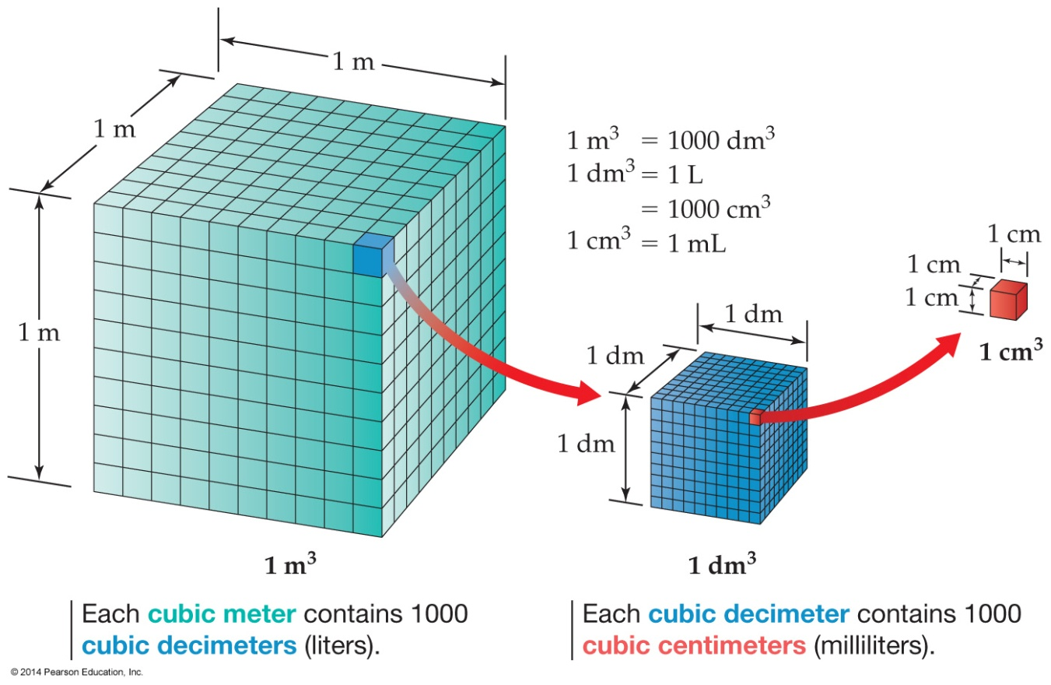
Convert 15 m³ to liters.
a) 1.5 × 10^{–2} L
b) 1.5L
c) 1.5 × 10² L
d) 1.5 × 10⁴ L
e) None of the above
Notes:
Answer: d

Slide 27
Convert 15 m³ to liters.
a) 1.5 × 10^{–2} L
b) 1.5L
c) 1.5 × 10² L
d) 1.5 × 10⁴ L
e) None of the above
Notes:
Answer: d

Slide 28
How many of the following numbers contain three significant figures?
0. 206 7.020 0.0 200 7.03 × 1024
a) one
b) one
c) one
d) one
e) None of the above
Notes:
Answer: c

Slide 29
How many of the following numbers contain three significant figures?
0. 206 7.020 0.0 200 7.03 × 1024
a) one
b) one
c) one
d) one
e) None of the above
Notes:
Answer: c

Slide 30
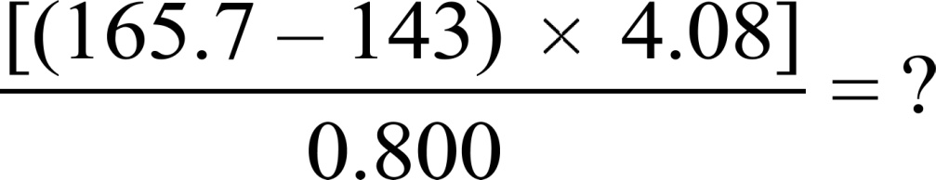
How many significant figures are there in the answer for the following problem?
a) one
b) two
c) three
d) four
e) None of the above
Notes:
Answer: b

Slide 31
How many significant figures are there in the answer for the following problem?
a) one
b) two
c) three
d) four
e) None of the above
Notes:
Answer: b

Slide 32

To the correct number of significant figures, what is the volume of the liquid in the graduated cylinder?
a) 7 mL
b) 7.0 mL
c) 7.5 mL
d) 8 mL
e) None of the above
Notes:
Answer: b

Slide 33
To the correct number of significant figures, what is the volume of the liquid in the graduated cylinder?
a) 7 mL
b) 7.0 mL
c) 7.5 mL
d) 8 mL
e) None of the above
Notes:
Answer: b

Slide 34

To the correct number of significant figures, what is the level of the liquid in the buret?
a) 0.2 mL
b) 0.29 mL
c) 0.3 mL
d) 0.35 mL
e) None of the above
Notes:
Answer: d

Slide 35
To the correct number of significant figures, what is the level of the liquid in the buret?
a) 0.2 mL
b) 0.29 mL
c) 0.3 mL
d) 0.35 mL
e) None of the above
Notes:
Answer: d

Slide 36
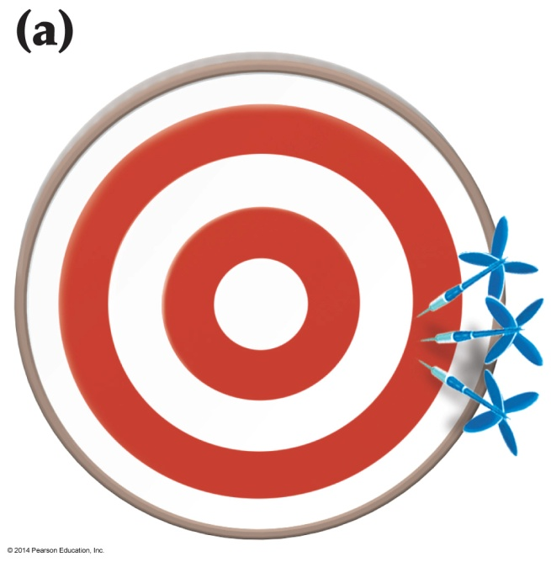
If hitting the bull's-eye is the desired result, Figure (a) represents
a) good accuracy and good precision.
b) good accuracy and poor precision.
c) poor accuracy and good precision.
d) poor accuracy and poor precision.
e) none of the above.
Notes:
Answer: c

Slide 37
If hitting the bull's-eye is the desired result, Figure (a) represents
a) good accuracy and good precision.
b) good accuracy and poor precision.
c) poor accuracy and good precision.
d) poor accuracy and poor precision.
e) none of the above.
Notes:
Answer: c

Slide 38
The LD50 values for several chemicals are listed as follows. These chemicals were tested on laboratory mice. Which was the most toxic to the mice in small amounts?
a) Aspirin, 1.5 g/kg
b) Chloroform, 3.2 g/kg
c) Ethyl alcohol, 10.6 g/kg
d) Sodium cyclamate, 17 g/kg
Notes:
Answer: a

Slide 39
The LD50 values for several chemicals are listed as follows. These chemicals were tested on laboratory mice. Which was the most toxic to the mice in small amounts?
a) Aspirin, 1.5 g/kg
b) Chloroform, 3.2 g/kg
c) Ethyl alcohol, 10.6 g/kg
d) Sodium cyclamate, 17 g/kg
Notes:
Answer: a

